Slide 1




SOUTH COTABATO
Demographic presentation
Provincial Population Office

Slide 2
OUTLINE OF THE PRESENTATION:
Aspirations of the Filipinos: AMBISYON Natin 2014
Demographic Transition and Demographic Dividend
Challenges faced by South Cotabato before harvesting the dividend
Key Messages and Policy Issues

Slide 3
AMBISYON NATIN 2040
DEVELOP long-term vision for Philippines by a nationwide study on the aspirations, values and principles of Filipinos (Objectives of Ambisyon 2040 are incorporated in the Executive Order No. 5).
Conducted using face-to-face personal interview of 10,000 respondents (M/F aged 15-50 y.o.) from ABCDE income homes during March 2015 by NEDA.
79% of Filipinos aspire for a simple and comfortable life. Whereas only 17% aspire to be well-off and only 4% want to be rich.

Slide 4
GOLDILOCK PERIOD:
Demographic window of opportunity and dividend
What is the Goldilock Period? = The demographic transition where the fertility rate is neither too high or too low as countries move from LARGE Families (High TFR) to SMALLER families (Low TFR).
IDEAL STABLE POPULATION fertility rate = 2.1 (Replacement Rate of Fertility)
Demographic Dividend = If Replacement TFR is reached, opportunity for HIGHER ECONOMIC GROWTH can be achieved

Slide 5
SOUTH COTABATO BASIC STATISTIC FIGURES
(Based on 2010-2015 POPCEN)
TOTAL POPULATION = 915,289
ANNUAL GROWTH RATE = 1.94
Male to female ratio = 51.2% MALE / 48.8% Female
TOTAL NUMBER OF HOUSEHOLDS = 217,944
AVERAGE HOUSEHOLD SIZE = 4.2
POPULATION DENSITY = 241 (per square kilometer)
TOTAL FERTILITY RATE = 3.25 *# of children per woman

Slide 6


DEMOGRAPHIC TRANSITION AND ITS IMPACT ON ECONOMIC GROWTH

Slide 7
Phase I:
Triggered by The initial decline in infant mortality, the young dependency ratio (0-14 years old) swells. Economic growth and saving rate are constrained since the young requires investment in health and education.
DEPENDENCY RATIO
THERE ARE = | 33.7 | CHILD DEPENDENTS
THERE ARE = | 4.2 | OLD DEPENDENTS
THERE ARE = | 61 | TOTAL DEPENDENTS
TOTAL WORKING AGE GROUP | 62.1% | Aged 15-64

Slide 8
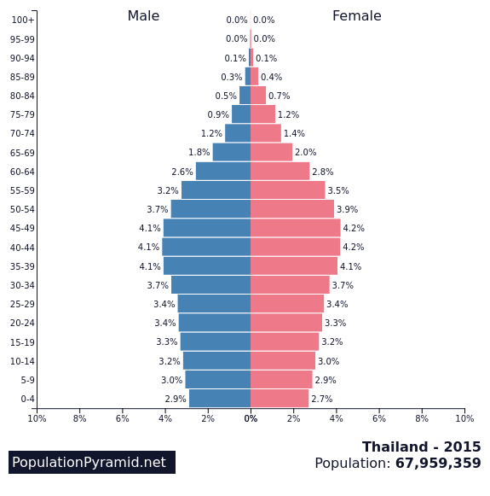
IN COMPARISOn with other population pyramid models:
Phase II:
ECONOMIC GROWTH CAN BE PROMOTED about 20 years later when the young dependents enter the working age group

Slide 9
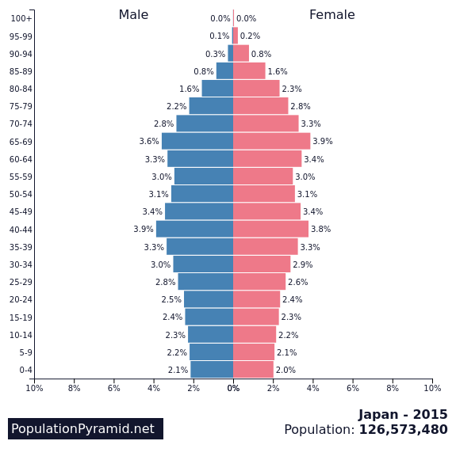
IN COMPARISOn with other population pyramid models:
Phase III:
ECONOMIC GROWTH CONTINUES as the elderly cohort swells, individuals accumulate saving in their working years to serve as buffer during the retirement years

Slide 10

DEMOGRAPHIC dividend and economic growth

Slide 11
FIRST DIVIDEND
Demographic Transition = higher per capita income due to higher productivity

Slide 12
SECOND DIVIDEND
Individuals accumulate saving
in their working years to serve as buffer during retirement.
When the society increases its saving rate, this
results in rapid economic growth, creating this
second demographic dividend.

Slide 13


HOW DO WE HARVEST THE Demographic dividend?

Slide 14
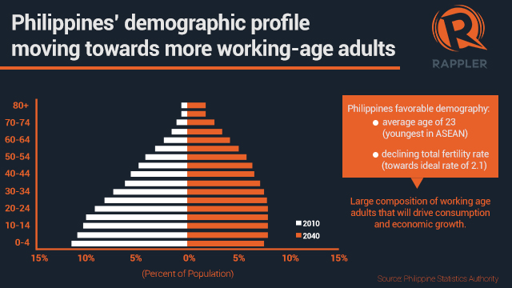
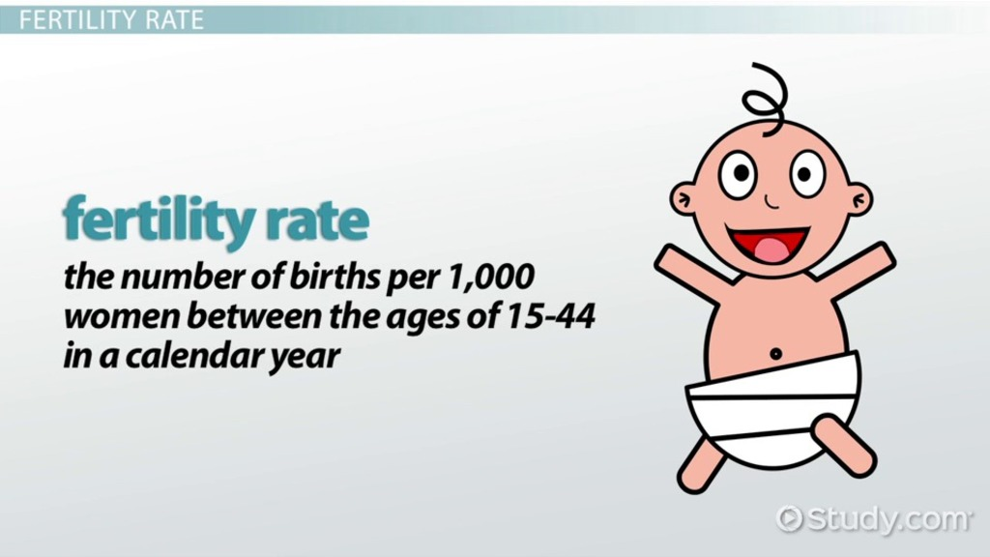
LOWER FERTILITY RATE IS CRUCIAL
Rapid, voluntary reduction in fertility rates directly affect the speeding up of this demographic transition
Sachs (2008) – Demographic transitions, where they have occurred, have typically been accelerated and even triggered, by proactive government policies.

Slide 15
LOWER FERTILITY RATE IS CRUCIAL
Relevant government policies that will have major influences in accelerating demographic transition: health services, family planning and education (particularly the secondary education), and increasing marrying age for women.

Slide 16
We have two challenges in harvesting demographic dividend

Slide 17
I. High fertility rate in households
(Based on 2015 POPCEN)
2000-2005 | 2005-2010 | 2010-2015
3.74 | 3.49 | 3.25
Ideal FR (National)
2.1

Slide 18

II. HIGH UNEMPLOYMENT RATE AMONG the young workers (15-24)
(SOCSKSARGEN DATA Based on LABOR FORCE SURVEY 2015 PSA)
TOTAL 15 years old and over | 3,133
LABOR FORCE Participation Rate | 60.4%
EMPLOYMENT RATE | 95.1%
UNEMPLOYMENT RATE | 4.9%
UNDEREMPLOYMENT RATE | 15.7%

Slide 19
JUST AS A PERSPECTIVE…

Slide 20



What if CPR will increase to 90% (from 72%) together with an additional two years of schooling?

Slide 21
DEMOGRAPHIC DIVIDEND is NOT AUTOMATIC!

Slide 22
KEY MESSAGES…
THE PROVINCE FACES A DEMOGRAPHIC WINDOW OF OPPORTUNITY
THERE ARE TWO MAJOR CHALLENGES TO CREATE THIS DEMOGRAPHIC DIVIDEND:
  SLOW REDUCTION IN FERTILITY RATE CREATING A HINDRANCE IN EXPLOITING THIS DEMOGRAPHIC GIFT.
  HIGH UNEMPLOYMENT RATE AND UNDEREMPLOYMENT RATES AMONG THE 20-24 YRS OLD GROUP

Slide 23
KEY MESSAGES…
LOWERING the fertility rate is a necessary condition to create demographic window of opportunity.
Targeting a high cpr and biased in favor of using the modern methods.

Slide 24
KEY MESSAGES…
Demographic dividend is not automatic! Groups belonging in age 20-24 will only be productive when they are employed.
Job-skills mismatch should be avoided

Slide 25
KEY MESSAGES…
The window of opportunity is closing fast…

Slide 26
Madamo nga salamat…

